Slide 1



Human resources slide 1
Astrosage Dataset Analysis
Presented by – SWATHI N S

Slide 2
PROBLEM STATEMENT
AstroSage has received a 1 crore investment and aims to optimize its call center operations. The goal is to determine how to allocate this investment to maximize operational efficiency, customer satisfaction, and profitability. The analysis will consider historical call data, performance metrics, and market trends to make informed decisions.

Slide 3
DATA OVERVIEW
ID/User ID: Identifies individual users and their consultations.
Guru Names/Guru ID: Indicates the astrologer or expert providing the consultation.
Consultation Type: Differentiates between chat and call consultations.
Mode of Consultation: Specifies the platform from which the consultation originated (e.g., app, website).
Creation Date/Time: Records when the consultation was initiated.
Chat and Call Status: Indicates whether a chat or call was completed, failed, or refunded.
Duration (Chat/Call): Measures the total time spent in each consultation.
Earnings and Payment: Financial details are shown in columns such as "Astrologer Earnings," "Net Amount," and "Amount.“
Rating: Allows users to rate their consultation experience.
This data can be analyzed to assess user behavior, guru performance, consultation outcomes, and financial metrics.

Slide 4
Human resources slide 2
GOALS:
The primary goal is deliver a clear and complete overview of data insights tailored to stakeholder needs.
Identify key trends and patterns by analyzing the data thoroughly.
Offer recommendations to improve customer satisfaction and service quality.
Suggest strategic investments in employee training, technology upgrades, and recruitment to enhance business performance.

Slide 5
Human resources slide 3
81%
DATA INFORMATION
(KPI)
Active USERS PER DAY :
Date vs. User Count Displays the total number of users for each specific date, providing a clear trend over time.
Operation cost
Retention Rate
54%
CHANGE IN CALL VOLUME :
Unique Users
Call Volume vs. Date Tracks the average daily call volume, highlighting changes and trends over different days
37%
Repeated callers
Out of 28027 total user, 22745 users are repeated users.
35%
CUSTOMER EXPERIENCE RATING:
Average call duration
Rating vs. User Count Reflects user satisfaction levels by showing how many users gave each rating.
119 sec

Slide 6
Human resources slide 4
TECHNIQUES :
DATA ANALYSIS:
The data is examined to assess key performance indicators (KPIs) and other critical metrics.
DASHBOARD:
The entire data is presented in a summarized dashboard format..
DATA CLEANING:
KEY INSIGHTS AND PATTERN:
The raw data is processed using various Excel functions and missing values are filled, and the data is properly formatted..
Offer recommendations based on the insights to enhance customer satisfaction and drive profitability.
Astrosage Dataset Analysis.

Slide 7

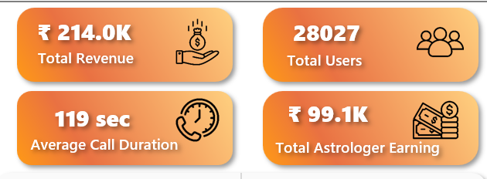



Human resources slide 5
KPI INDICATORS
(Key performance indicator)
Total Revenue: This figure represents the overall income generated from all types of consultations and platforms, showcasing the platform's financial success.
Total Users: The total number of active users engaging with the platform, which reflects user base expansion and engagement levels.
Average Call Duration: The average length of consultation calls, providing insight into typical user interaction time.
Total Astrologer Earnings: The cumulative earnings of astrologers, emphasizing the platform's ability to provide meaningful revenue opportunities for astrologers.

Slide 8
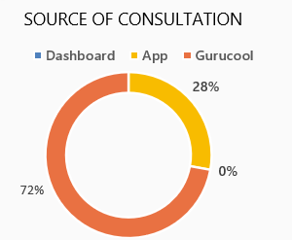
.
CONSULTATION SOURCES
72% via App: The app clearly stands out as the dominant platform for consultations, showcasing its strong user preference.
28% via Dashboard: While the dashboard is less popular, it still accounts for a significant portion of consultations and should not be overlooked.
0% via Gurucool: With no recorded consultations, Gurucool currently shows no user activity. This signals either limited engagement or an untapped opportunity for growth
Insights
Given that the app is the primary driver of consultations, it’s essential to continue enhancing its performance.
Additionally, a deep dive into Gurucool’s inactivity is warranted to identify potential barriers and develop strategies to unlock its capabilities, ensuring it serves its full potential in future user engagement.

Slide 9
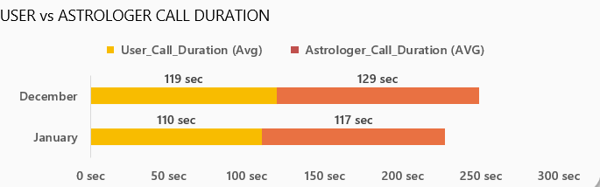
CALL DURATION: USER vs ASTROLOGER
December:
Users: 119 seconds
Astrologers: 129 seconds
January:
Users: 110 seconds
Astrologers: 117 seconds
Insights:
The slight reduction in call durations for both users and astrologers in January could indicate a potential correlation with the dip in revenue and user engagement.
Although the durations remain fairly stable, it’s important to monitor this trend to ensure performance stays on track and any underlying issues are addressed promptly.

Slide 10
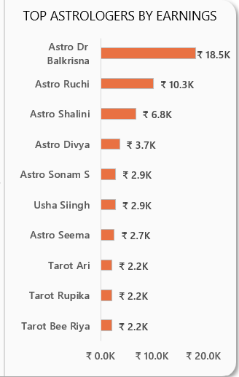
TOP EARNING ASTROLOGER
Astro Dr. Balkrisna is the top earner with ₹18.5K, followed by Astro Ruchi (₹10.3K) and Astro Shalini (₹6.8K).
Insights:
Astro Dr. Balkrisna's impressive income may stem from an increase in consultations or premium pricing.
It would be valuable to explore their approach and identify successful strategies that could be shared with other astrologers to enhance their own practices.

Slide 11
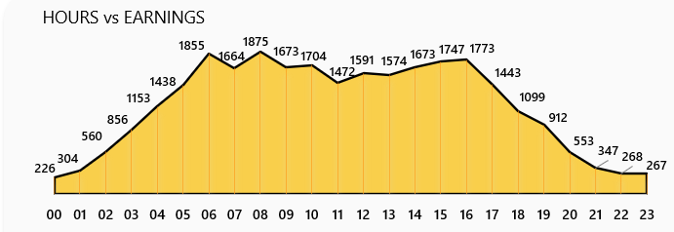
EARNINGS BY HOUR
Peak Hours: Earnings are highest between 7 AM and 12 PM.
Low Hours: Earnings drop sharply after 9 PM.
Insights:
Maximize the impact of peak morning hours by enhancing visibility and launching tailored promotions.

Slide 12
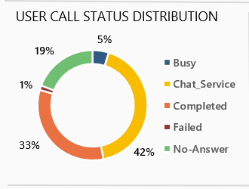
CALL STATUS ANALYSIS
42% Chat Service: A strong indicator of successful user engagement via chat, reflecting a high rate of effective interactions.
33% Completed Calls: Suggests there may be challenges around user availability or engagement levels, which could be impacting call completion rates.
19% No-Answer, 5% Busy, 1% Failed: Points to potential system inefficiencies or low adoption of other communication methods, signaling an opportunity for process improvement and broader engagement strategies.

Slide 13
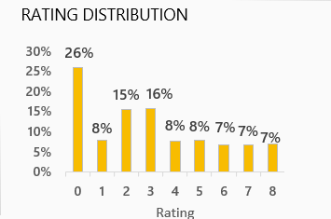
USER RATINGS
26% Rated “0”: A considerable percentage of users seem dissatisfied or disengaged, highlighting a key area of concern.
Ratings between 6-8: Comprise just 22%, suggesting there is considerable opportunity to improve the overall user experience.
Insights:
Prioritize addressing user concerns by identifying pain points, resolving complaints, and enhancing the quality of service.
These efforts could help shift user sentiment towards more positive ratings.

Slide 14
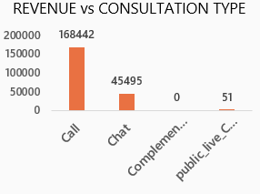
REVENUE vs CONSULTATION TYPE
Call Service Revenue Contribution:
An impressive 78.72% of the company’s total
net income is generated exclusively from call
services.
Call consultations dominate, contributing the highest revenue (168,442), followed by Chat (45,495).
Other consultation types, such as "Complementary" and "public_live_Call," generate negligible or no revenue.
Insights:
Enhance customer experience, scale operational capacity, and introduce premium features or packages to maximize revenue potential.
Conduct a cost-benefit analysis of "Complementary" and "public_live_Call" services to determine if they should be improved, repositioned, or discontinued.

Slide 15
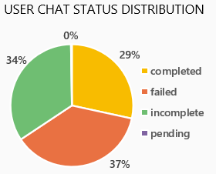
CHAT STATUS ANALYSIS
A significant portion of chats (37%) fail, highlighting issues in the current process or system.
Incomplete chats (34%) are nearly as high, indicating user drop-offs or unresolved interactions.
Completed chats are limited to 29%, showing opportunities to improve resolution rates and overall effectiveness.
Insights:
Analyze and address failure and drop-off causes by improving chat workflows, automation, and user support processes.
Enhance completion rates by integrating guided steps, escalation options, and feedback-driven improvements.

Slide 16
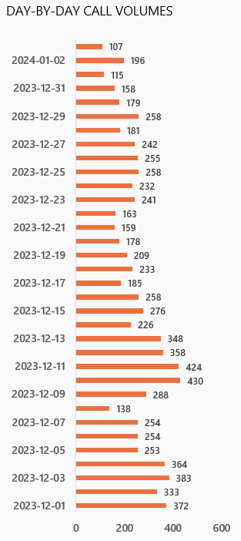
CALL VOLUME DAY-BY-DAY
The call center handles an average of 250 calls daily.
The peak call volume was recorded at 430 on 10th December 2023.
The lowest call volume, 107, occurred on 3rd January 2024.
December had the highest call volume, while January experienced the lowest.
While the center receives approximately 250 calls per day, only 56.41% are fully resolved by astrologers.
Insights:
Recruiting additional skilled agents and freelancers is essential to alleviate the workload on current staff and improve service efficiency.

Slide 17
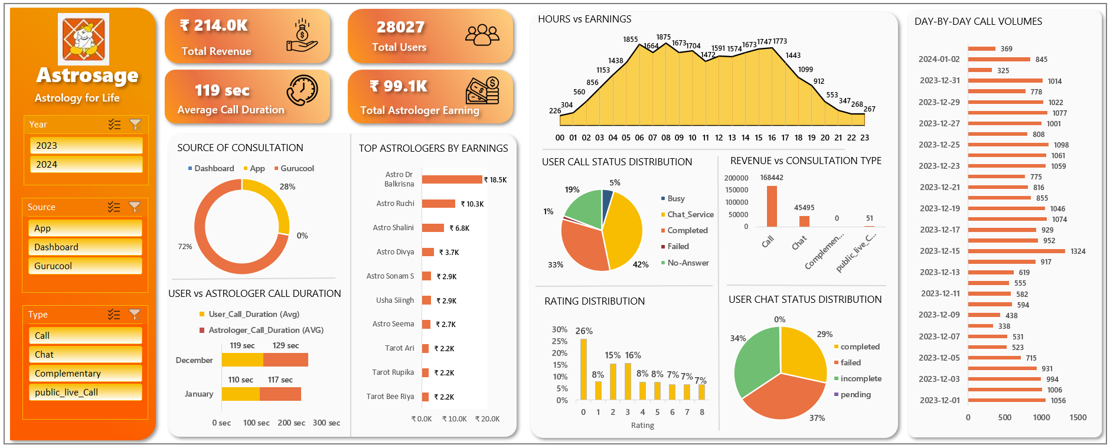
Human resources slide 8
DASHBOARD
.

Slide 18
RECOMMENDATIONS
Optimize Morning Sessions: Prioritize marketing and operational strategies during the 7 AM–12 PM time frame to capitalize on peak revenue opportunities.
Enhance User Experience: Focus on improving user satisfaction by addressing low ratings and high no-answer instances. Strengthen user engagement and implement better support systems.
Leverage High-Performers: Examine the strategies of top-performing astrologers, such as Astro Dr. Balkrisna, and apply their successful methods across the broader team to boost overall performance.
Activate Gurucool: Investigate the low activity on Gurucool and identify ways to optimize its features, making it more engaging and valuable for users and astrologers alike.
Prepare for Seasonal Trends: Use the insights gained from December’s high performance to plan for similar seasonal spikes, ensuring preparedness to manage demand effectively and mitigate potential declines.

Slide 19

Human resources slide 10
Thank You

